Slide 1
Design Navigation with Deep Learning
Amit Regmi

Slide 2
Purpose and Motivation
Understanding the design context or designer’s sentiment
Navigate current design and recommend next parts using Deep Learning (LSTM RNN)

Slide 3
Milestone
Pre-Processing Big Data
BOM/Graph JSON extraction
SeriesID to Vector representation
Design Sequence data creation
Visualizing cluster data
Clustering SeriesID
LSTM RNN network development
Hyper parameter tuning
Accuracy Improvement and Iteration

Slide 4
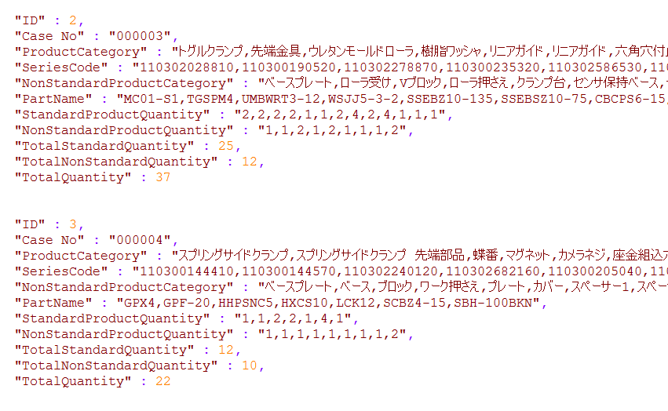
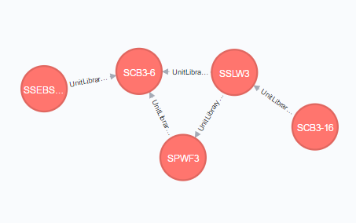
Pre-Processing Big Data
BOM JSON file extraction of 800 Unit
Graph Database of 10,000 component nodes with relation mates

Slide 5
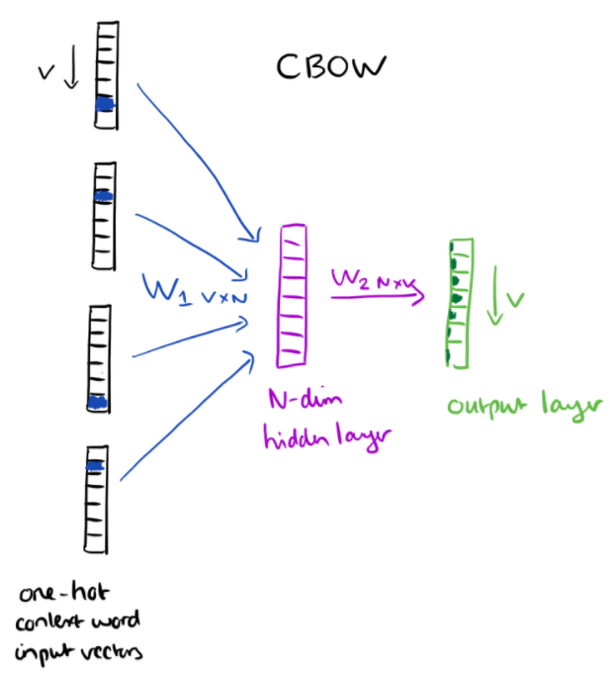
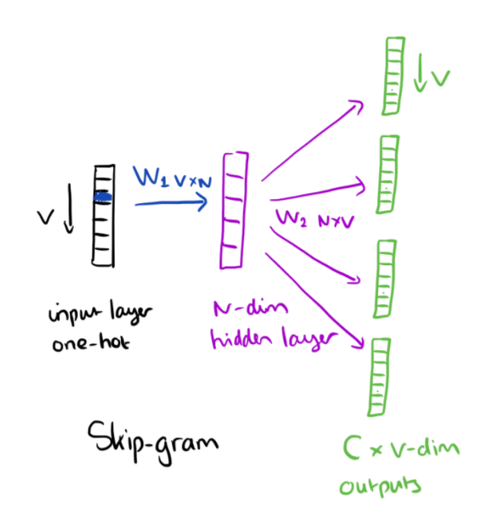

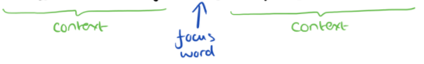
SeriesID to Vector Representation
Vector[
0.02761004,
-0.32874903,
0.21700616,
...,
-0.32157031,
-0.11029019,
-0.16800487], type=float32)
Shaft Holder
Shaft Holder
shaft
Washer
Shaft
Washer
Hexagonal
Nut
Hexagonal
Nut
Knock Pin
Sequence from BOM
Knock Pin
“Shaft Holder”, ”Washer”
”Shaft”
”Hexagonal Nut”, ”Knock Pin”
Source: word2vec by google

Slide 6
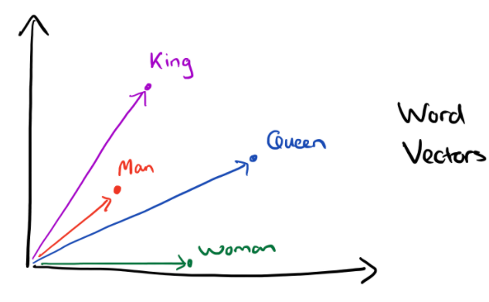
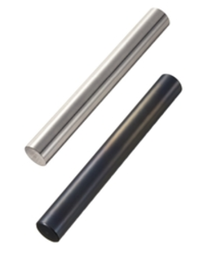
SeriesID to Vector Representation
“Linear Shaft” SeriesID[110302634310]
Linear Shaft
[110302634310]
Vector[
0.02761004,
-0.32874903,
0.21700616,
...,
-0.32157031,
-0.11029019,
-0.16800487], type=float32)
Rotary Shaft
[110300086920]
Shaft Holder
[110300010440]
Bearing, [110300107650]
Bearing, [110300107740]
Bearing Holder, [110300101530]
Linear Shaft
Rotary Shaft
Shaft Holder
Bearing
model.most_similar(positive=[‘110302634310’, ‘110300086920’], negative=[‘110300010440’]) = [110300107650]

Slide 7
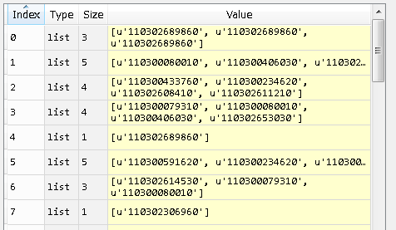
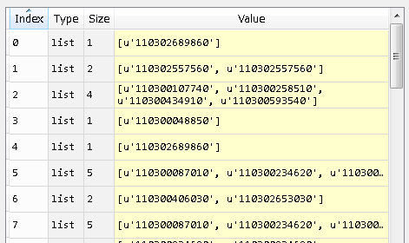
Design Sequence Data Creation
BOM Sequence for Unit 0644
{110302689860,110302689860,110302689860,110302689860,110300449520,110300452840,110302593010,110302614530,110300079310,110300080010,110300406030………110302653030,110300048850…}
Random Generation of Design Sequence example:
{110302689860,110302689860,110302689860} -> {110302689860}
{110300449520,110300452840,110302593010,110302614530} -> {110300079310,110300080010,110300406030}
{110302653030} -> {110300048850}
X{Question}
Y{Answer}

Slide 8
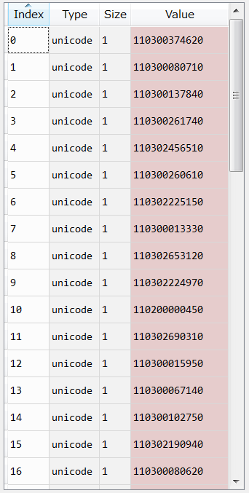
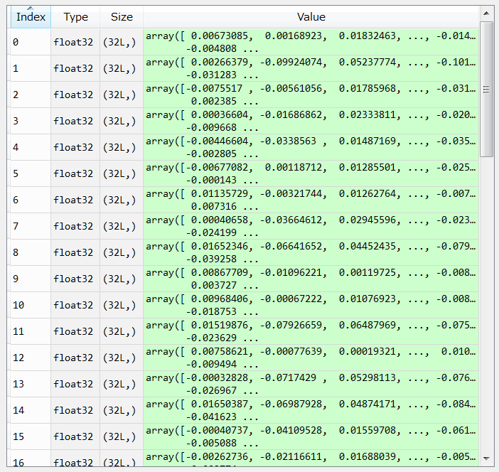
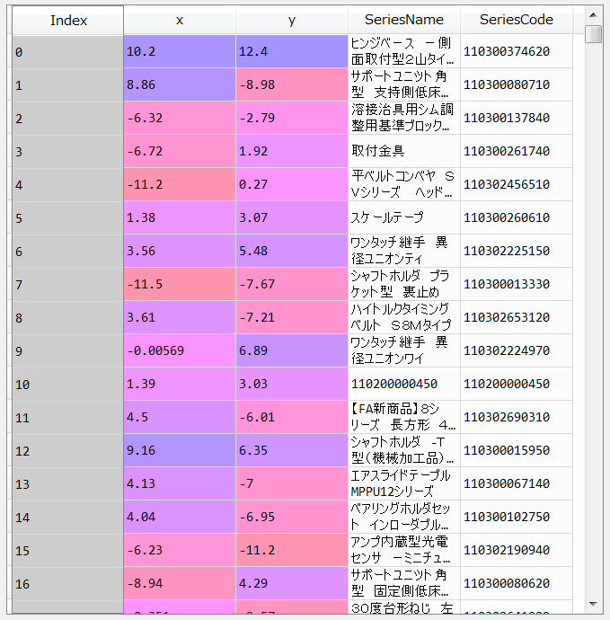
Visualizing Cluster Data
Dimension Reduction by using t-sne algorithm
32 Dimension of SeriesID Vector
2 Dimension of SeriesID Vector
Dimension Reduction

Slide 9
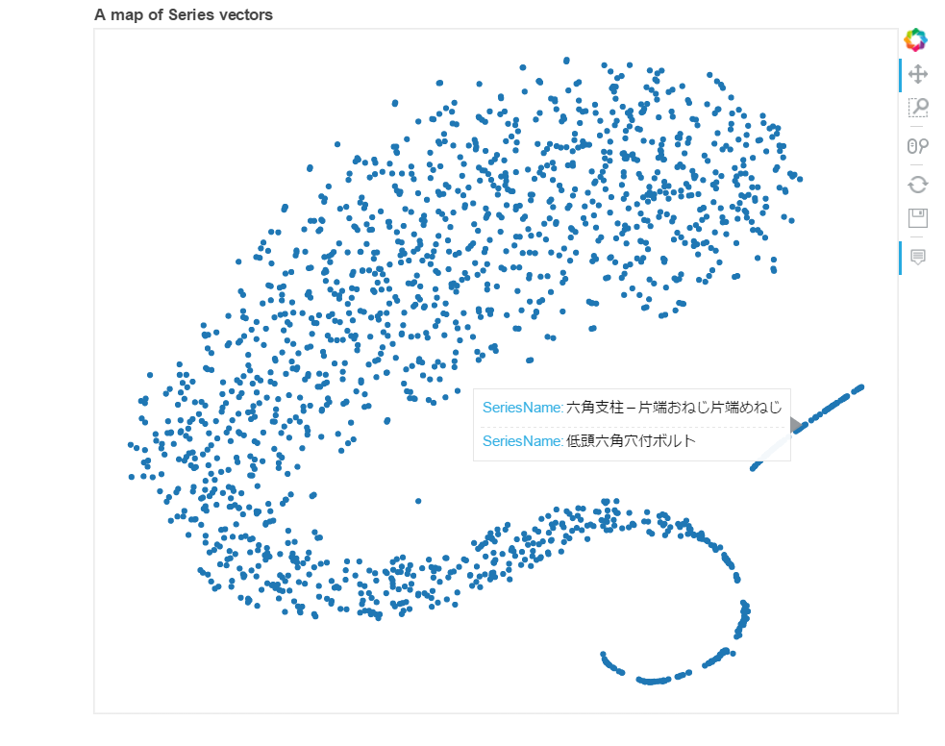
Visualizing Cluster Data

Slide 10
課題
LSTM RNN network development
Hyper parameter tuning
Accuracy Improvement and Iteration

Slide 11
LSTM RNN Network Development
Hyper-Parameter Understanding
Memory unit, Forget Unit
Back Propagation Through Time(BPTT)
Activation and Initialization
Loss function and optimization
Current LSTM network
model = Sequential()
model.add(LSTM(output_dim=32,input_shape=x_train.shape[1:],return_sequences=True,init='glorot_normal',inner_init='glorot_normal',activation='sigmoid'))
model.add(LSTM(output_dim=32,input_shape=x_train.shape[1:],return_sequences=True,init='glorot_normal',inner_init='glorot_normal',activation='sigmoid'))
model.add(Dropout(0.5))
model.add(LSTM(output_dim=32,input_shape=x_train.shape[1:],return_sequences=True,init='glorot_normal',inner_init='glorot_normal',activation='sigmoid'))
model.add(LSTM(output_dim=32,input_shape=x_train.shape[1:],return_sequences=True,init='glorot_normal',inner_init='glorot_normal',activation='sigmoid'))
model.add(Dropout(0.5))
model.add(Dense(y_test.shape[2], activation='softmax'))

Slide 12
Accuracy Improvement and Iteration

